Slide 1
Design and Analysis of Algorithms
Algorithms-II : CS345A
Website: hello.iitk.ac.in
Lecture 3
Divide and Conquer Paradigm - III

Slide 2
Recap from Lecture 1

Slide 3
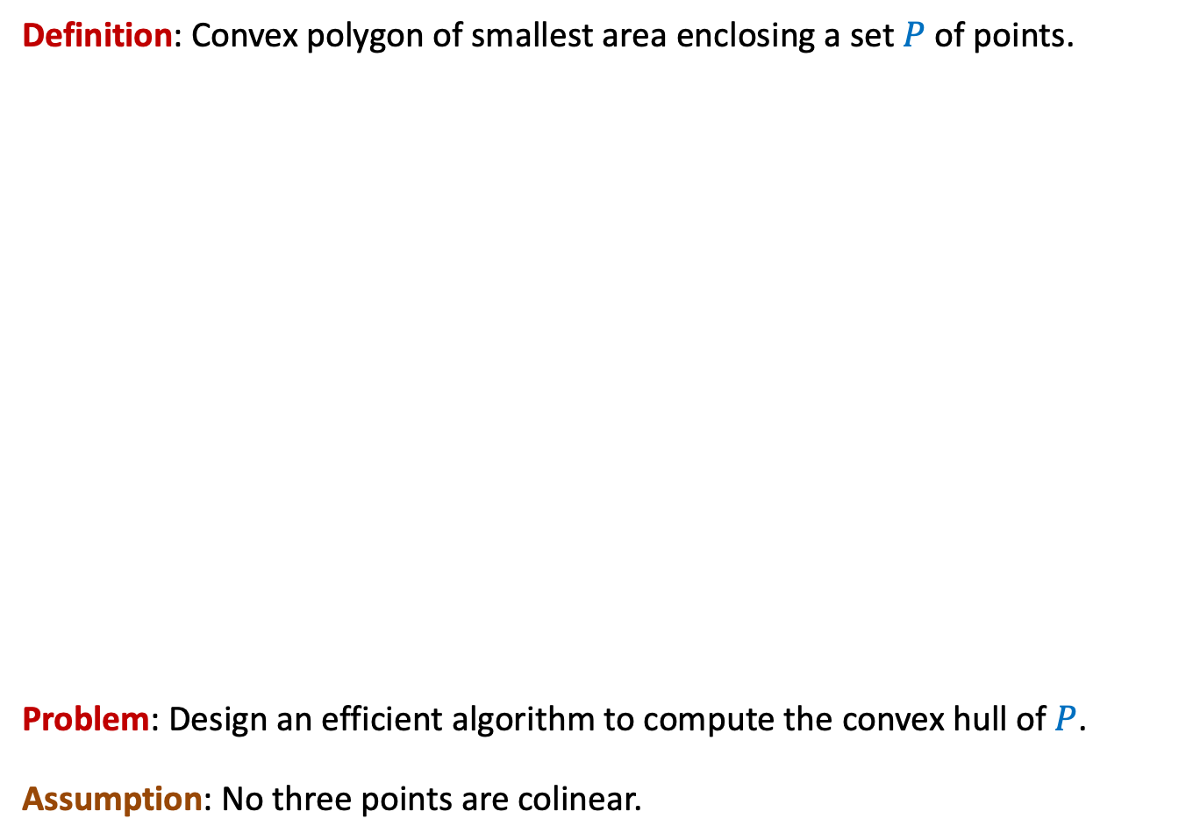
Convex hull
Definition: Convex polygon of smallest area enclosing a set $P$ of points.
Problem: Design an efficient algorithm to compute the convex hull of $P$.
Assumption: No three points are colinear.

Slide 4



The Divide Step
O($n$) time
Left half set
$⌈\frac{n}{2}⌉$points
$⌊\frac{n}{2}⌋$points
Right half set

Slide 5

Solving the subproblems recursively
2 T($\frac{n}{2}$) time
Left half set
$⌈\frac{n}{2}⌉$points
$⌊\frac{n}{2}⌋$points
Right half set

Slide 6
The Conquer step
Left half set
$⌈\frac{n}{2}⌉$points
$⌊\frac{n}{2}⌋$points
Right half set

Slide 7
A simpler problem
The right half set is a point

Slide 8

The right half set is a point
$$p$$

Slide 9


The right half set is a point
$$q$$
Tool 1
Upper tangent
$$p$$
Lower tangent
$$r$$

Slide 10
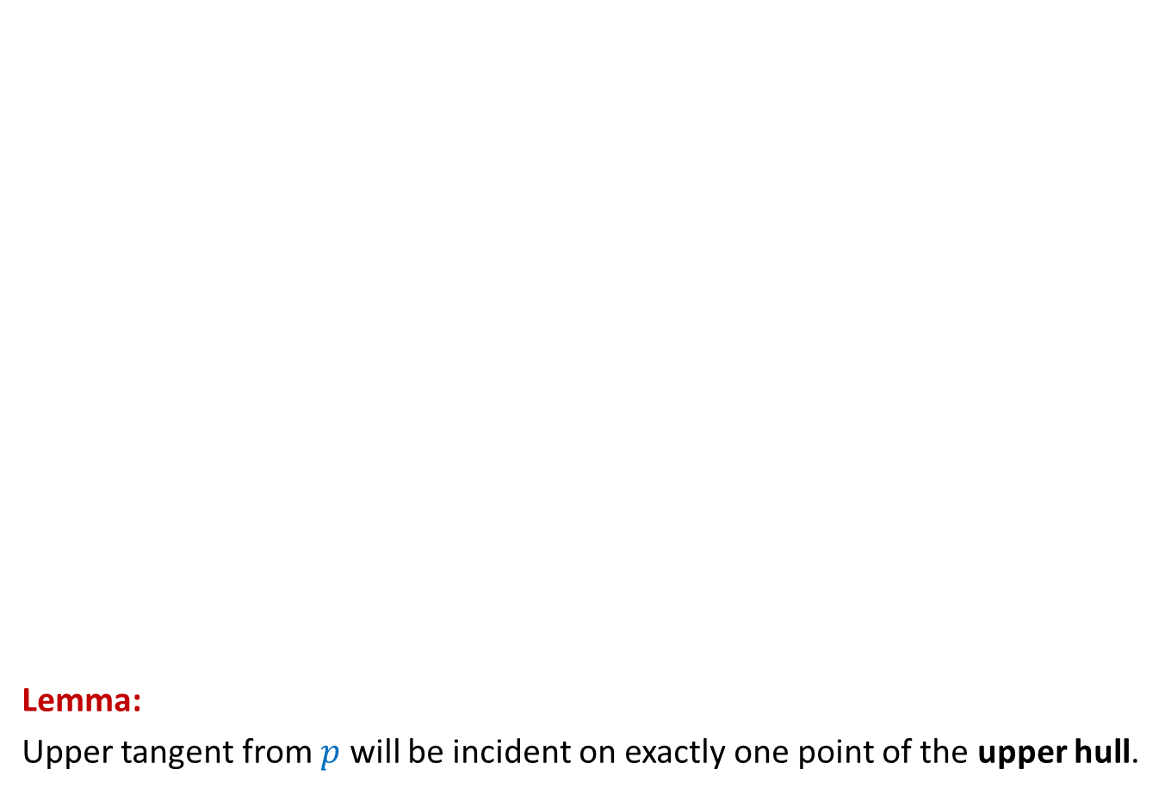
The right half set is a point
Lemma:
Upper tangent from $p$ will be incident on exactly one point of the upper hull.
Upper Hull
Upper tangent
$$p$$
$$p$$

Slide 11
The right half set is a point
Lemma:
Lower tangent from 𝑝 will be incident on exactly one point of the Lower hull.
$$p$$
$$p$$
Lower tangent
Lower Hull

Slide 12
How to compute the upper tangent ?
$$p$$

Slide 13




How to compute the upper tangent ?
$$s$$
Tool 2
$$q$$
$$t$$
$$p$$
$$r$$

Slide 14

How to compute the upper tangent ?
$$r$$ | $$q$$ | $$s$$ | $$t$$
$$s$$
$$q$$
$$t$$
$$p$$
$$r$$

Slide 15
How to compute the upper tangent ?
$$r$$ | $$q$$ | $$s$$ | $$t$$
$$s$$
$$q$$
$$t$$
$$p$$
$$r$$

Slide 16


How to compute the upper tangent ?
$$r$$ | $$q$$ | $$s$$ | $$t$$
$$s$$
$$q$$
O(log $n$) time
Upper tangent
binary search
$$t$$
$$p$$
$$r$$

Slide 17

The Conquer step
Upper tangent
Lower tangent
$\frac{n}{2}$points
$\frac{n}{2}$points

Slide 18






How to compute the upper tangent ?
O($n$log $n$) time
$$w$$
$$x$$
$$v$$
$$u$$
$$y$$
$\frac{n}{2}$points
$\frac{n}{2}$points

Slide 19

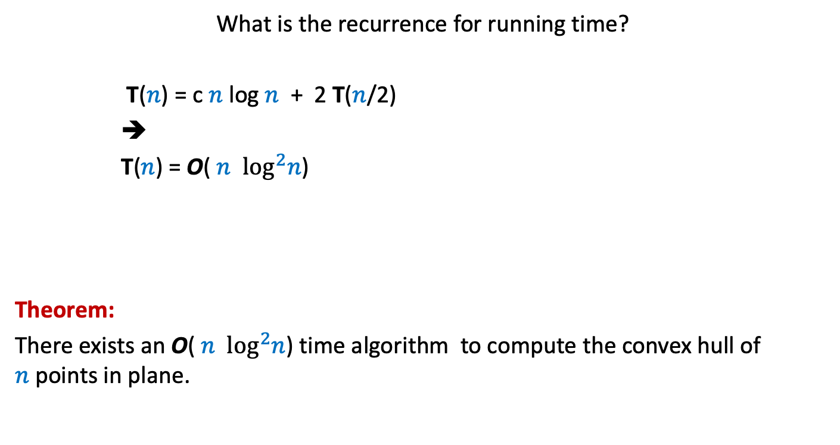
Running time of the algorithm
What is the recurrence for running time?
T($n$) = c $n$ log $n$ + 2 T($n$/2)
➔
T($n$) = O( $n$ $\log^{2}n$)
Theorem:
There exists an O( $n$ $\log^{2}n$) time algorithm to compute the convex hull of $n$points in plane.
c $n$

Slide 20
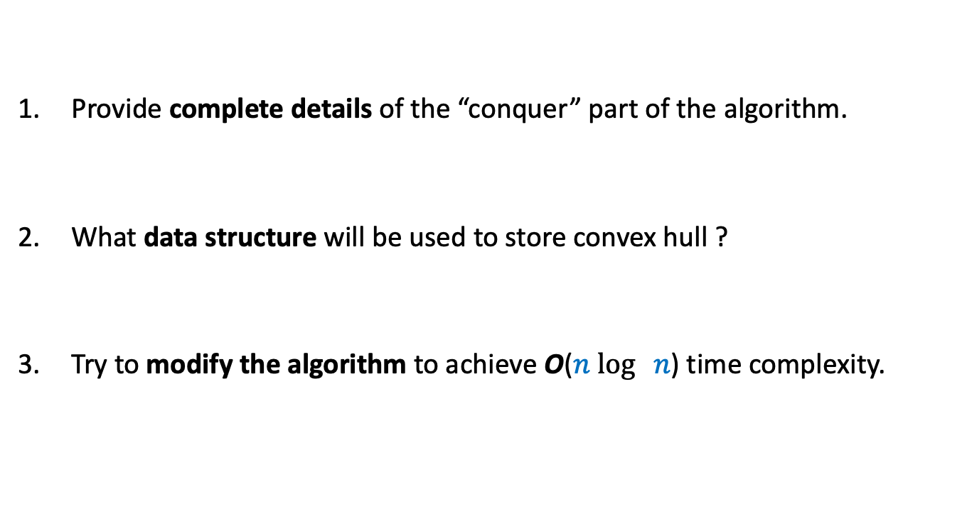
Homework
Provide complete details of the “conquer” part of the algorithm.
What data structure will be used to store convex hull ?
Try to modify the algorithm to achieve O($n$ $\log{ n}$) time complexity.

Slide 21
An algorithm for multiplying two polynomials
Problem 3

Slide 22
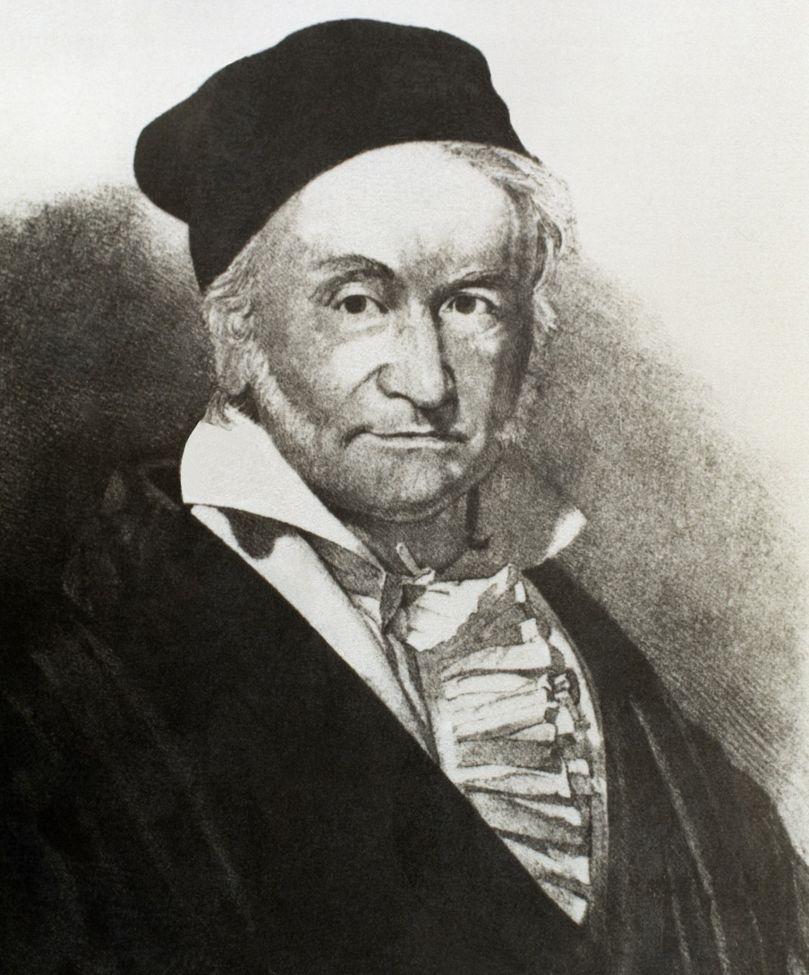
Carl Friedrich Gauss (1777-1855)

Slide 23
Multiplying two polynomials
Definition (polynomial of degree less than $n$)
$$A\left(x\right)=a_{0}+a_{1}x+a_{2}x^{2}+ …a_{n−1}x^{n−1}$$
Problem : Given two polynomial of degree less than $n$,
$$A\left(x\right)=a_{0}+a_{1}x+a_{2}x^{2}+ …a_{n−1}x^{n−1}$$
$$B\left(x\right)=b_{0}+b_{1}x+b_{2}x^{2}+ …b_{n−1}x^{n−1}$$
Compute $C=A × B$
$$C\left(x\right)=\sum_{0≤i<2n−1}{c_{i}x^{i}}$$
where $c_{i}$ =
Trivial algorithm: O( $n^{2}$)
Aim: O( $n$ $\log{n}$)
Applications:
Signal processing (Discrete Fourier Transform)
As practical as sorting and searching
Multiplication of two integers.
$$a_{0}b_{i}+a_{1}b_{i−1}+a_{2}b_{i−2}+ …+a_{i−1}b_{1}+a_{i}b_{0}$$
O($i$) time

Slide 24
Representation of a polynomial ?
Coefficient representation:
$$A\left(x\right)=a_{0}+a_{1}x+a_{2}x^{2}+ …a_{n−1}x^{n−1}$$
$<a_{0}, a_{1},a_{2},…,a_{n−1}>$

Slide 25
Representation of a polynomial ?
Alternate representation of polynomial
“$A\left(x\right)=a_{0}+a_{1}x$”
{$(r_{0}, A\left(r_{0}\right)),(r_{1}, A\left(r_{1}\right))$}
for any distinct $r_{0}$ and $r_{1}$uniquely define $A\left(x\right)$.
Alternate representation of polynomial “$A\left(x\right)=a_{0}+a_{1}x+a_{2}x^{2}$”
{$(r_{0}, A\left(r_{0}\right)),(r_{1}, A\left(r_{1}\right))$, $(r_{2}, A\left(r_{2}\right))$}
for any distinct $r_{0}$,$r_{1}$, and $r_{2}$ uniquely define $A\left(x\right)$.
$$(r_{1}, A\left(r_{1}\right))$$
$$(r_{2}, A\left(r_{2}\right))$$
$$(r_{0}, A\left(r_{0}\right))$$
$$(r_{1}, A\left(r_{1}\right))$$
$$(r_{0}, A\left(r_{0}\right))$$

Slide 26
Representation of a polynomial ?
Theorem:
Let {$(r_{0},t_{0}),(r_{1},t_{1})$, …, $(r_{m−1}, t_{m−1})$} be $m$ pairs of numbers with all $r_{i}$’s distinct.
There exists a unique polynomial $A$ of degree less than $m$ such that
$A\left(r_{i}\right)=t_{i}$ $∀ i$
Proof: Elementary matrix theory.
Do it as a Homework.
(point,value) representation of a polynomial

